Slide 1
Team 2 WFH
Albert Ang, Hany Jasmine, Victoria Luo

Slide 2
Introduction
Relevance of studying effects of remote work on overall health
The study was conducted over 6 months
Determine whether participants work an average of three locations per week and the subsequent effects of it
Total of 70 participants with full-time jobs working remotely 90% of the time, use the computer at least 4 hrs/day, equipped with Garmin watches
The watch would ping the participants three times a day to share information such as their current location, level of discomfort, and number of breaks.

Slide 3
Progress
Hypothesis analysis using combination of the 2-month data
Ended up using 4-month data as it was the most conclusive
Drew insights from correlating a few other features with location
Compared number of locations worked from with factors such as heart rate, stress, pulse oximetry, and average daily breaks

Slide 4
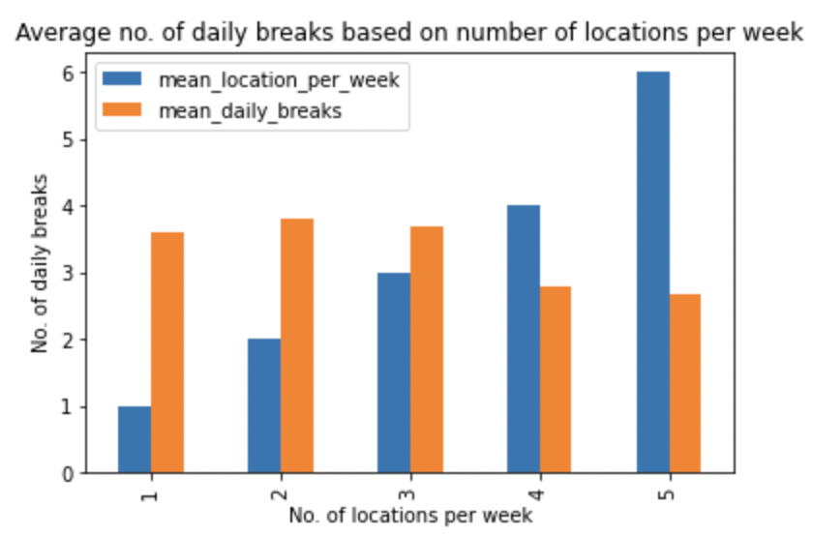
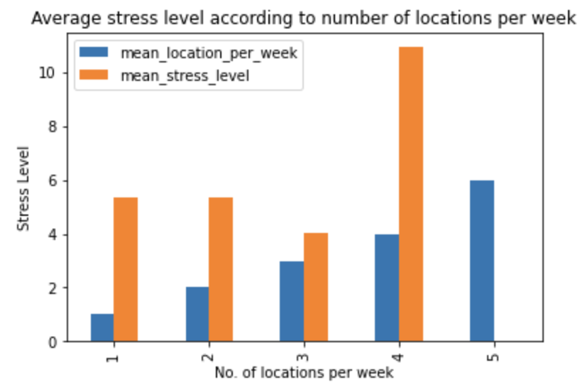
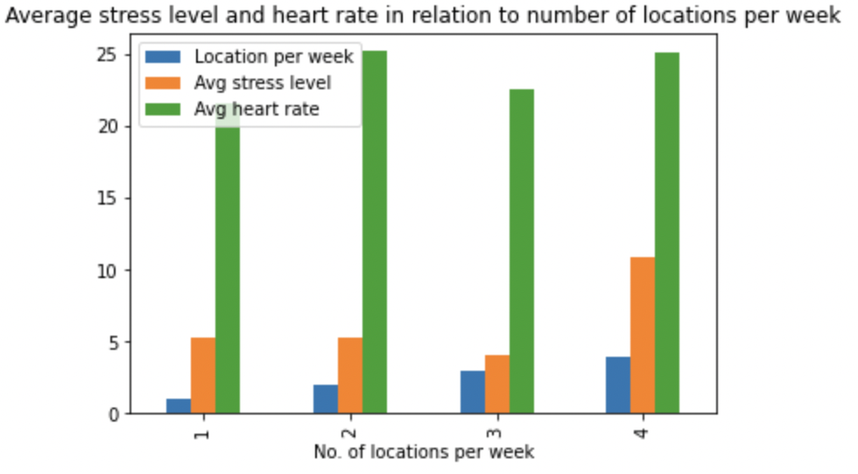
Early Results
Change in locations does not necessarily equate to lower stress levels
People generally take less breaks if they had worked more in more than 2 different locations per week
Direct positive correlation between heart rate and stress levels
Challenges
Handling NaN values for week (200+ for AM data)

Slide 5
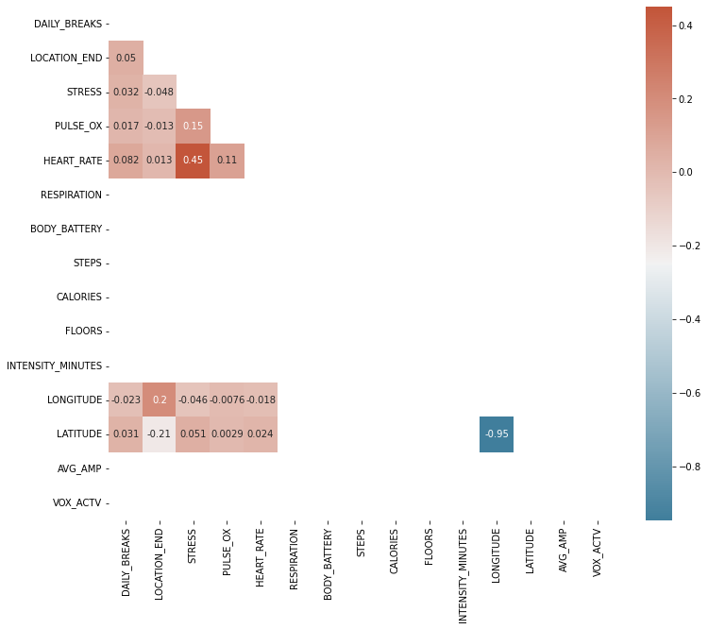
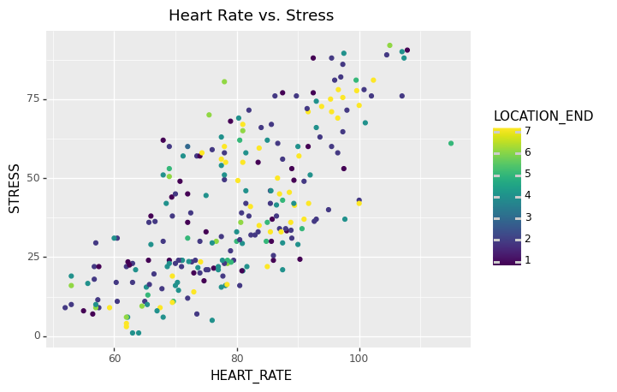
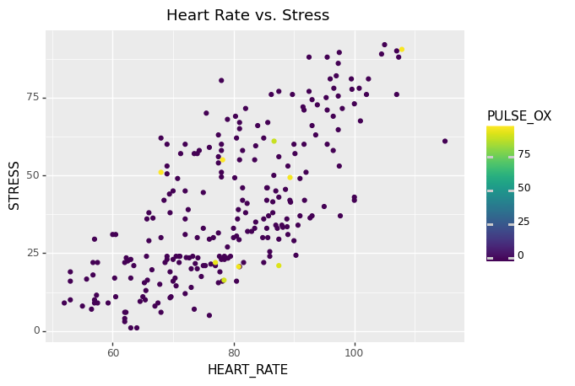
Early Insights
Challenges:
Handling of NaN/0 values
Inconsistency in data reports

Slide 6
Challenges Incurred/Next Steps
We had to assume the integer values assigned to location were unique locations for every participant
Look more closely at the AM/PM data
Evaluate changes related to stress levels, heart rate, etc. specific to participants working in the morning vs. the afternoon
Comparing participants that work in the morning and those that work in the afternoon
Change in values for certain features per day
Merging of datasets could be a challenge

